Slide 1
Tip: For longer titles, use lowercase, for shorter titles put in all uppercase
12-31-20
By First Last Name

Slide 2
Tip: For longer titles, use lowercase, for shorter titles put in all uppercase

Slide 3
Tip: For longer titles, use lowercase, for shorter titles put in all uppercase

Slide 4
Printer friendly cover slide

Slide 5
Agenda
For fewer or shorter agenda lists
01
02
03
Section 1 title or description text
Section 2 title or description text
Section 3 title or description text
04
05
06
Section 4 title or description text
Section 5 title or description text
Section 6 title or description text

Slide 6
Agenda
For more or longer agenda lists
01
Section 1 title or longer description text
06
Section 6 title or longer description text
02
Section 2 title or longer description text
07
Section 7 title or longer description text
03
Section 3 title or longer description text
08
Section 8 title or longer description text
04
Section 4 title or longer description text
09
Section 9 title or longer description text
05
Section 5 title or longer description text
10
Section 10 title or longer description text

Slide 7
Update the number to match each section number
01

Slide 8
Use for printed presentations only
Update the number to match each section number
02

Slide 9

Tip: Image has a solid fill layer on top of image set to 35% transparency. Place on top of photos to make text more legible
“
Quote fact or description text here. Aut eos nim archit acerum ditione derum audae perum nis.”
Name and Year

Slide 10

Tip: Quote mark, circle, and yellow line can be deleted or moved if not needed.
“
Name and Year
Tip: To replace photo, delete, then click on icon to insert picture. To alter placement, click photo, select Picture Format tab / Crop / move photo to desired placement / Crop

Slide 11
00%
00%
00%
00%
Subtext for description of
the stats
Subtext for description of
the stats
Subtext for description of
the stats
Subtext for description of
the stats
Tip: Circles can be deleted or moved if not needed.

Slide 12
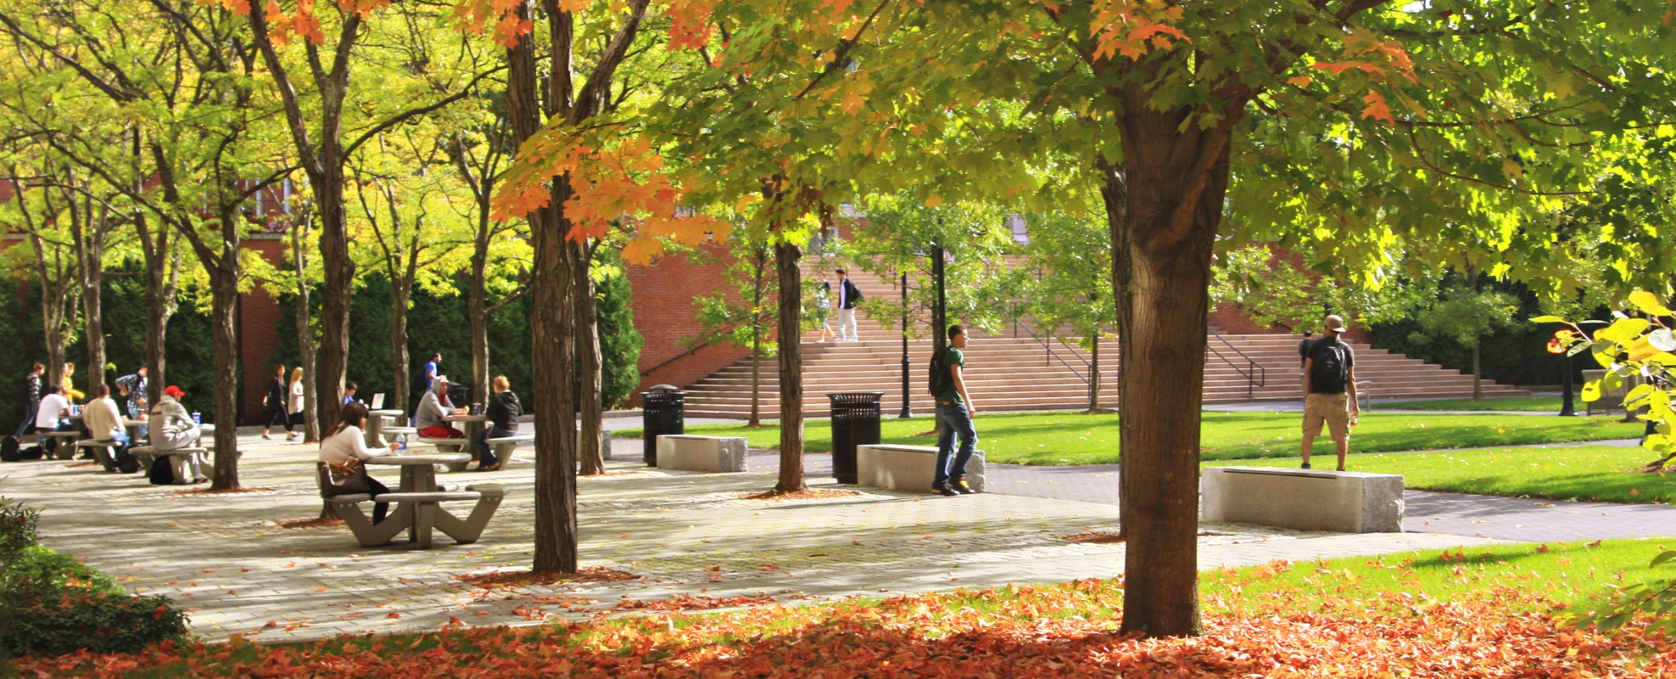
Tip: To replace photo, delete, then click on icon to insert picture. To alter placement, click photo, select Picture Format tab / Crop / move photo to desired placement / Crop
00%
00%
00%
00%
Subtext for description of
the stats
Subtext for description of
the stats
Subtext for description of
the stats
Subtext for description of
the stats
Tip: Circles can be deleted or moved if not needed.

Slide 13
BODY COPY OR FACTS. Ut que endandit maio cusciumquia ducim ellignatis erum estiandi ad que porestis aut eos nim archit acerum ditione derum audae perum nis quostiae eario verupta doluptatasi aut qui od magnimolupta qui consequidem. Nam faceatur.
Ut que endandit maio cusciumquia ducim ellignatis erum estiandi ad que porestis aut eos nim archit acerum ditione derum audae perum nis quostiae eario verupta doluptatasi aut qui od magnimolupta qui consequidem. Nam faceatur.
BODY COPY OR FACTS. Ut que endandit maio cusciumquia ducim ellignatis erum estiandi ad que porestis aut eos nim archit acerum ditione derum audae perum nis quostiae eario verupta doluptatasi aut qui od magnimolupta qui consequidem. Nam faceatur.
Ut que endandit maio cusciumquia ducim ellignatis erum estiandi ad que porestis aut eos nim archit acerum ditione derum audae perum nis quostiae eario verupta doluptatasi aut qui od magnimolupta qui consequidem. Nam faceatur.

Slide 14
Tip: Visit bentley.edu/brand to access the icon library and customize the visuals below
Aut eos nim archit acerum ditione derum audae perum nis quostiae.
Aut eos nim archit acerum ditione derum audae perum nis quostiae.
Aut eos nim archit acerum ditione derum audae perum nis quostiae.
Aut eos nim archit acerum ditione derum audae perum nis quostiae.

Slide 15
INTRO TEXT. Ut que endandit maio cusciumquia ducim ellignatis erum estiandi ad que porestis aut eos nim archit acerum ditione derum. Ut que endandit maio cusciumquia ducim ellignatis erum estiandi ad que porestis aut eos nim archit acerum ditione derum.
Ut que endandit maio cusciumquia ducim ellignatis erum estiandi ad que porestis aut eos nim archit acerum ditione derum.
73%
40%
TITLE
Molorro dolorerio explitio corername
TITLE
Molorro dolorerio explitio corername

Slide 16
aut eos nim archit acerum ditione derum audae perum nis quostiae eario verupta doluptatasi aut qui od magni molupta qui.
aut eos nim archit acerum ditione derum audae perum nis quostiae eario verupta doluptatasi aut qui od magni molupta qui.
aut eos nim archit acerum ditione derum audae perum nis quostiae eario verupta doluptatasi aut qui od magni molupta qui.
aut eos nim archit acerum ditione derum audae perum nis quostiae eario verupta doluptatasi aut qui od magni molupta qui.

Slide 17
Slide Title
00
Subtext for description of
the stats
Body copy or facts. Ut que endandit maio cusciumquia ducim. Ut que endandit maio cusciumquia ducim
Ellignatis erum estiandi ad que porestis aut eos nim archit acerum ditione derum audae perum nis quostiae eario verupta doluptatasi aut qui od magnimolupta qui consequidem. Nam faceatur.
Ellignatis erum estiandi ad que porestis aut eos nim archit acerum ditione derum audae perum nis quostiae eario verupta doluptatasi aut qui od magnimolupta qui consequidem. Nam faceatur.
00
Subtext for description of
the stats
00
Subtext for description of
the stats

Slide 18
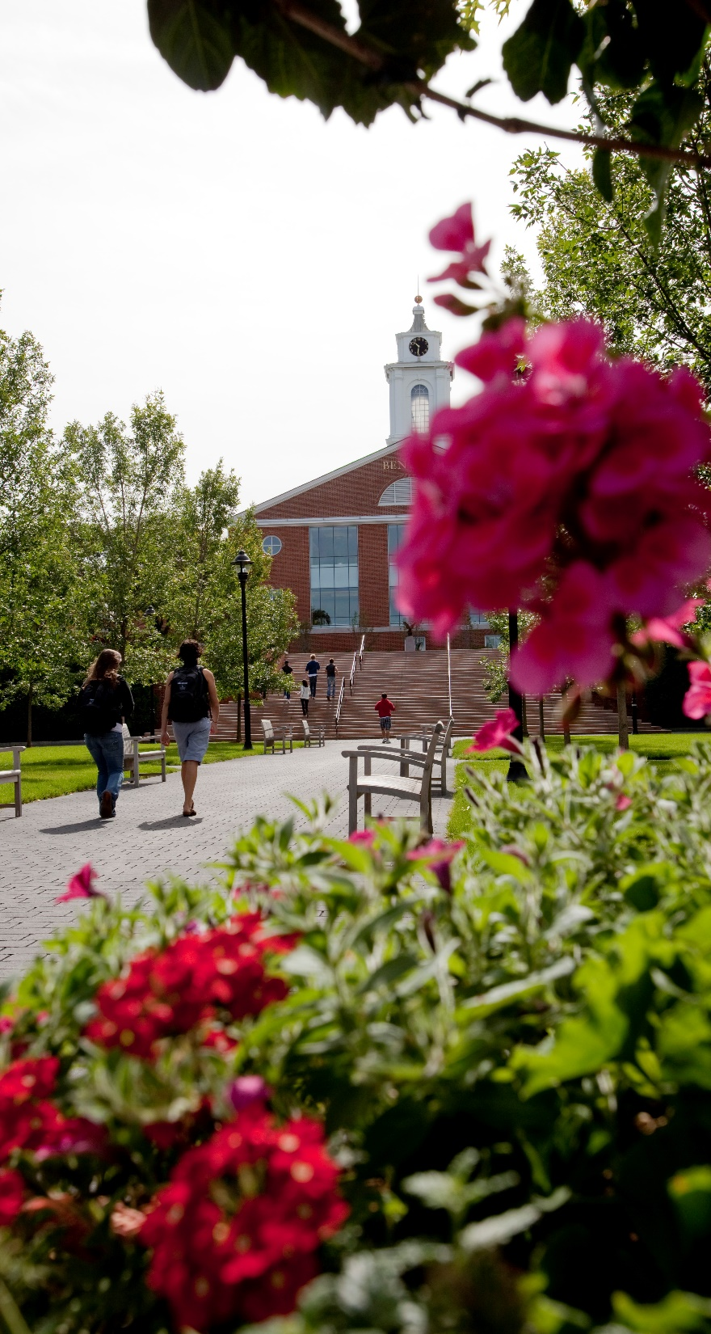
Slide Title
Body copy or facts. Ut que endandit maio cusciumquia ducim. Ut que endandit maio cusciumquia ducim.
Tip: To replace photo, delete, then click on icon to insert picture. To alter placement, click photo, select Picture Format tab / Crop / move photo to desired placement / Crop

Slide 19
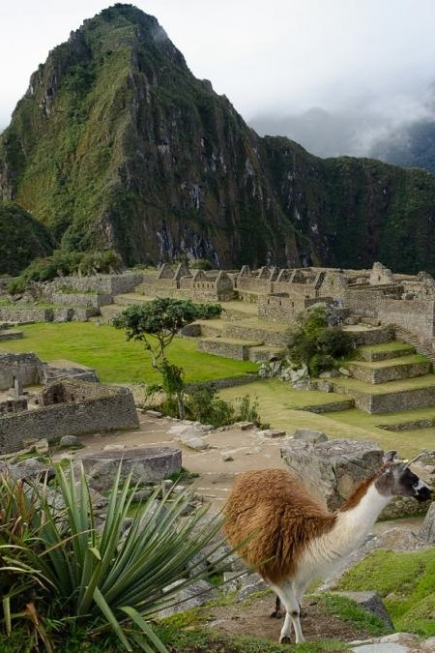


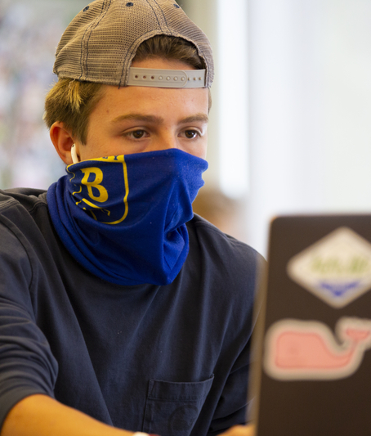

Tip: To replace photos, delete, then click on icon to insert picture. To alter placement, click photo, select Picture Format tab / Crop / move photo to desired placement / Crop
Visit photography.bentley.edu for more photo options. Or delete images not needed and place a blue background with white text.

Slide 20
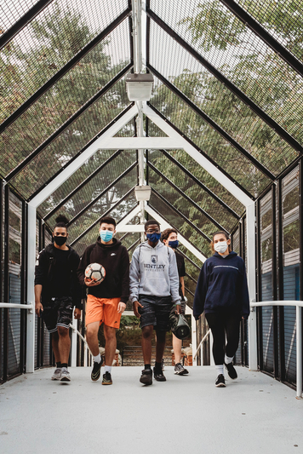
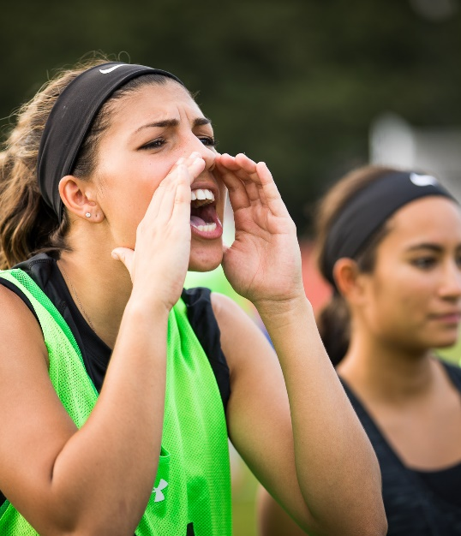
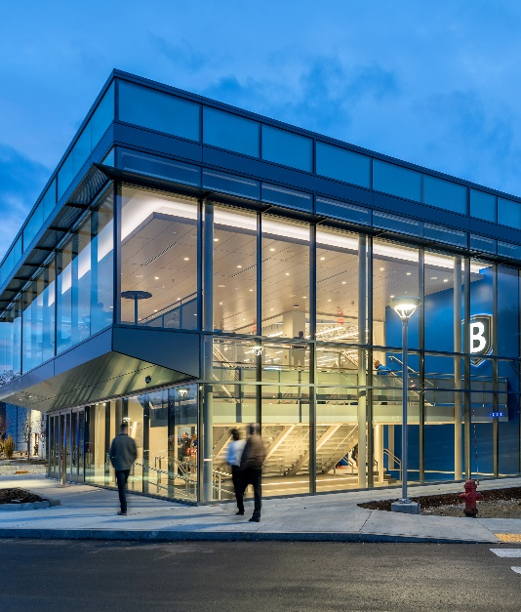
Tip: To replace photos, delete, then click on icon to insert picture. To alter placement, click photo, select Picture Format tab / Crop / move photo to desired placement / Crop
Visit photography.bentley.edu for more photo options. Or delete images not needed and place a blue background with white text.

Slide 21
Thank you

